Slide 1

Spam Analyzer
NLP – I
Monsoon 2014
IIIT Hyderabad
Mahesh Billa(201450837)
Pinak Chakraborty (201450816)

Slide 2
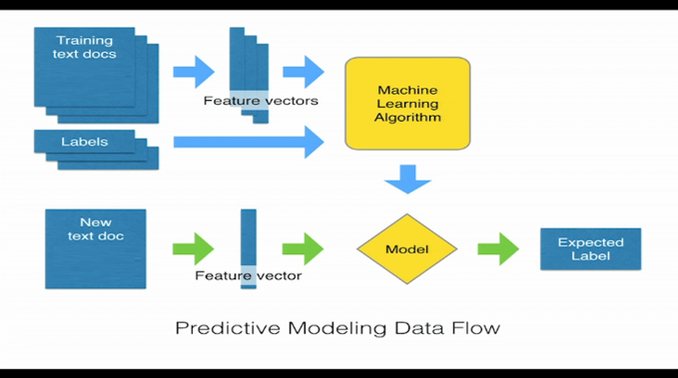
Problem Formulation
This is a classification problem which we attempt to resolve using supervised machine learning algorithms.
We will describe the steps mentioned in the flow diagram below in the rest of this presentation:
Feature Extraction
Dataset (Training)
Classifier
Calculated Parameter
Dataset
(Test/live)
Outcome

Slide 3
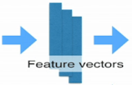
Feature Engineering
We parsed the emails and removed all stop words, like, determinants (A, An, The), Conjunctions (And, Or) from feature set that are not meaningful for sentiment analysis.
We use NLP POS Tagging algorithms to POS tag the words used for extraction
This extraction process reduced dimension of feature vector but preserved the necessary information for spam detection

Slide 4
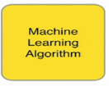
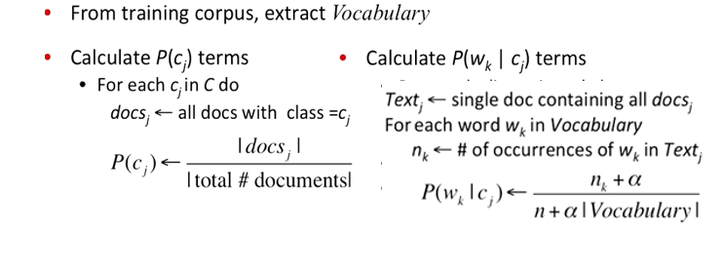


Solution Approaches (cont’d)
We have used A Naïve Bayesian classifier for Spam detection
We will use a classifier based on support vector machine later in the project.
A Naive Bayesian classifier works as follow:
Learning
Analysing
Compute class probability using the following equation:

Slide 5
Solution Approaches (to be developed)
Support Vector Machines : We use the SVM with a linear kernel.
Our input text is converted into numeric vector with each vector corresponds to the presence of a feature.
For example, with a unigram feature extractor, each feature is a single word found in a tweet. If the feature is present, the value is 1, but if the feature is absent, then the value is 0.
We use feature presence, as opposed to a count, which speeds up overall processing.

Slide 6
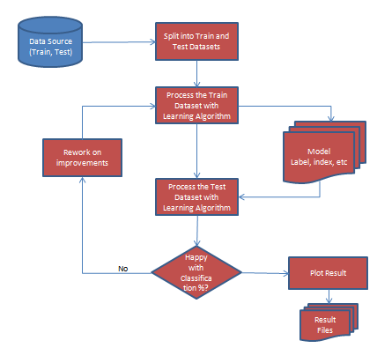
High Level Components
Data Source
(Train, Test)
Split into Train and Test Datasets
Process the Train Dataset with Learning Algorithm
Model
Label, index, etc
Rework on improvements
Process the Test Dataset with Learning Algorithm
Happy with Classification %?
No
Plot Result
Result Files

Slide 7

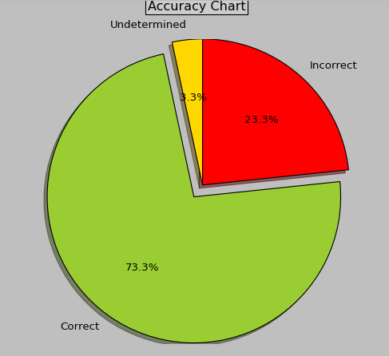
Experiments
Naïve Bayesian classifier returns around 75% accuracy when run on unigram features.
SVM on unigram features is yet to be developed at tested (was not part of the project, but would provide a good comparison of two classifier models)
We will try out the classifiers by taking bigrams and trigrams features as well.

